Slide 1


<Anaya León Daniela>
<January 12th of 2025>

Slide 2

Outline
Executive Summary
Introduction
Methodology
Results
Conclusion
Appendix

Slide 3
Executive Summary
Summary of methodologies
Data Collection with API and Web Scraping
Data Wrangling
Exploratory Data Analysis with SQL and Data Visualization
Machine Learning Prediction
Summary of all results

Slide 4
Introduction
Space X is one of the most famous and profitable companies, they have a considerably high percentage of successful landings and, in addition, they sell rockets launches for 62 million dollars while other companies' costs rise to 165 million dollars.
Being able to predict whether a landing will be successful will allow the company to increase its value and be more successful.
Problems you want to find answers

Slide 5

Section 1

Slide 6
Methodology
Executive Summary
Data collection methodology:
The data was collected using API and Web Scrapping from Wikipedia.
Perform data wrangling
The data was analyzed and a label was created to convert and store successful and failed landings from outcome data.
Perform exploratory data analysis (EDA) using visualization and SQL
Perform interactive visual analytics using Folium and Plotly Dash
Perform predictive analysis using classification models
The data was divided into training and test to do the training, 4 different models were evaluated and their accuracy was analyzed.

Slide 7
Data Collection
Describe how data sets were collected.
The data was collected using a JSON request.
Then it was normalized to turn it into a pandas dataframe.
We cleaned the data from missing values and replaced them with the mean of the other values.
We create a BeautifulSoup object to obtain the html data.
We extract the launch data and create a pandas dataframe.

Slide 8
Data Collection – SpaceX API
Use the get request to obtain the data
Process and normalize the data with .json_normalize()
Filter the data to have only dato of Falcon 9
Look for missing values and replace them with function mean()
Create and sabe the dataframe
https://github.com/danielaanaya262/DataScience/blob/main/1.%20Jupyter-labs-spacex-data-collection-api.ipynb

Slide 9
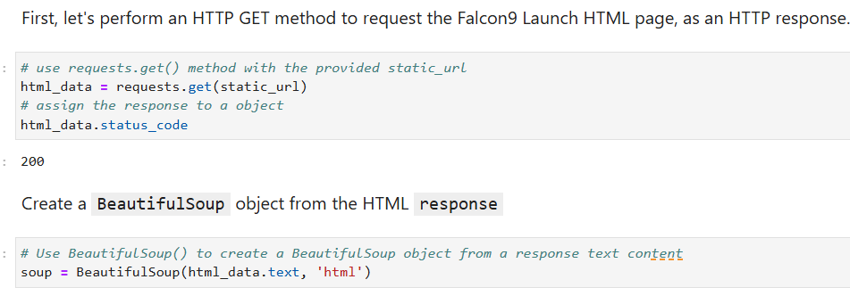
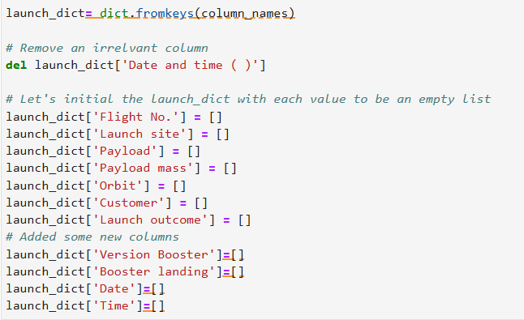
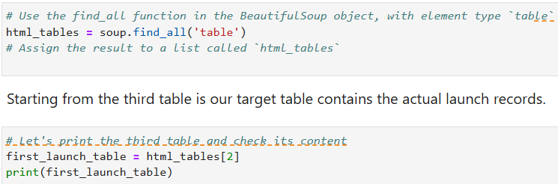
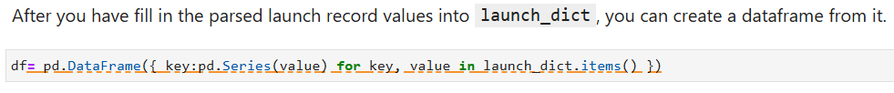
Data Collection - Scraping
3
1
2
4
https://github.com/danielaanaya262/DataScience/blob/main/2.%20Jupyter-labs-webscraping.ipynb

Slide 10
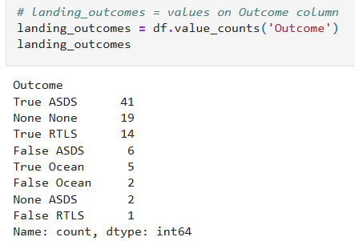
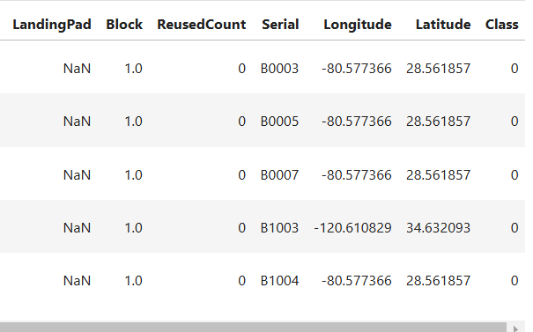
Data Wrangling
First we analyze the data with the function .dtypes
We calculate the number of launches with .value_count()
Then we calculate the number of landing outcomes with the same function
We convert the data of the outcome into a Training Label with a classification of 1 for a successful landing and 0 for unsuccessful.
https://github.com/danielaanaya262/DataScience/blob/main/3.%20Labs-jupyter-spacex-Data%20wrangling.ipynb

Slide 11
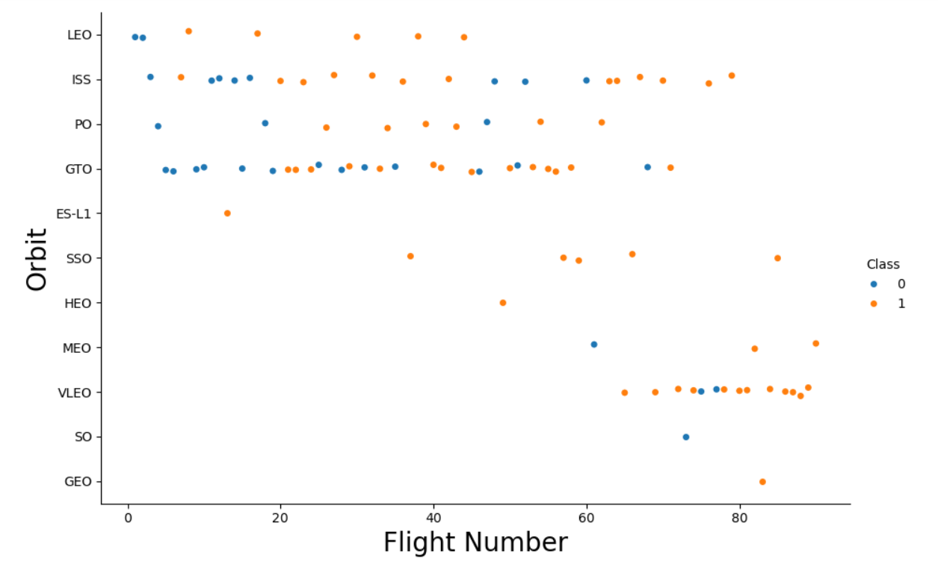
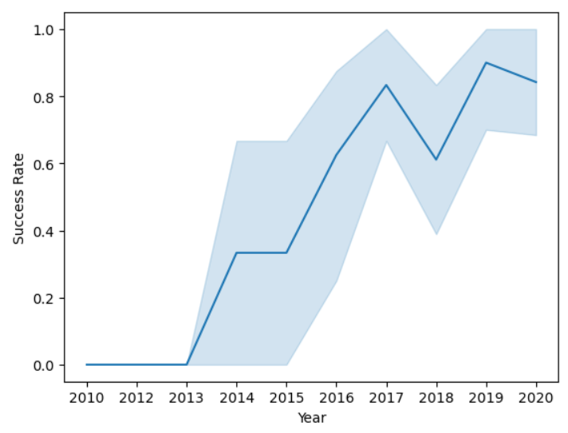
EDA with Data Visualization
We use scatter point chart, histogram and line chart to compare and visualize the data.
https://github.com/danielaanaya262/DataScience/blob/main/5.%20Jupyter-labs-eda-dataviz-v2.ipynb

Slide 12
EDA with SQL
SQL queries you used:
The names of the unique launch sites.
Five launch Sites with the string “CCA”.
The total (sum) of payload mass carried by boosters launched bay NASA (CRS).
Average payload mass carried by booster version F9 v1.1.
First successful landing outcome in ground pad.
Names of the success boosters with a payload mass between 4000 and 6000.
The number of outcomes.
https://github.com/danielaanaya262/DataScience/blob/main/4.%20Jupyter-labs-eda-sql-coursera_sqllite.ipynb

Slide 13
Build an Interactive Map with Folium
Markers, circles, lines and markers clusters were used:
Markers for launch sites.
Circles for highlighted areas on specifics coordinates (ex. NASA Johnson Space Center at Houston, Texas)
Lines to visualize the distance between the launch site to its closest city, railway, highway, etc.
Markers clusters to indicate if the launch was successful (green) or unsuccessful (red).
https://github.com/danielaanaya262/DataScience/blob/main/6.%20Lab-jupyter-launch-site-location.ipynb

Slide 14
Build a Dashboard with Plotly Dash
We built graphs in an interactive dashboard using Ploty Dash to visualize the data.
Pie charts were plotted to compare and visualize the data.
The total of success launches by sites were visualized with a pie chart.
We visualized the successful and failed launches of the site with a pie chart too.

Slide 15
Predictive Analysis (Classification)
We load the cvs data and transform with numpy and pandas, then we standardized it.
We split the data into training and test.
We built four different machine learning models (logistic regression, support vector, decision tree and k nearest neighbors) using GridSearchCV.
Then we calculate the accuracy and plot a confusion matrix for each one.
To finish, we compare all the methods to see which one is the best.
https://github.com/danielaanaya262/DataScience/blob/main/8.%20SpaceX-Machine-Learning-Prediction-Part-5-v1.ipynb

Slide 16
Results
Exploratory data analysis results
Interactive analytics demo in screenshots
Predictive analysis results

Slide 17

Section 2

Slide 18
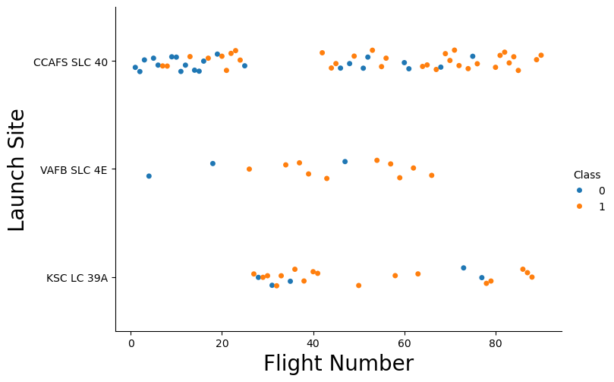
Flight Number vs. Launch Site
We can see that when the flight numbers increases the successful launches increases too.

Slide 19
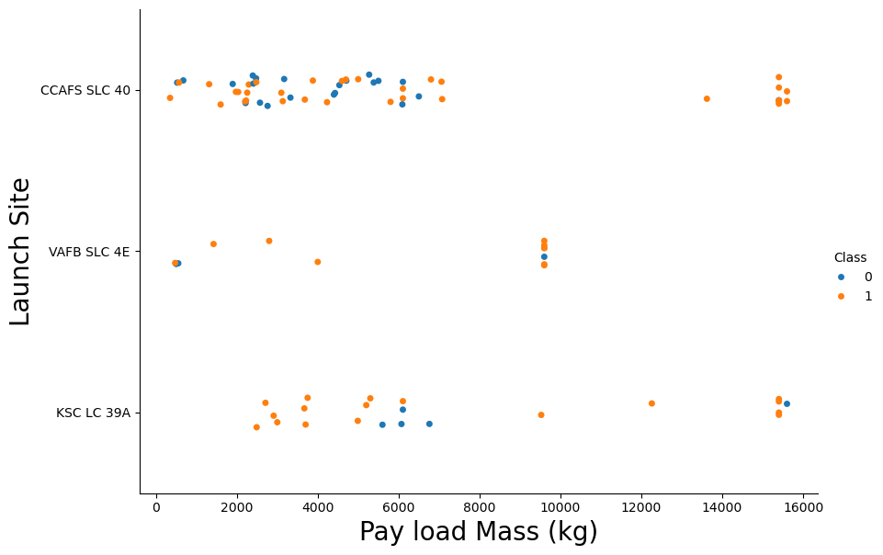
Payload vs. Launch Site
Launches with the highest payload mass (greater than 8,000 kg) seem to be the most likely to be successful.

Slide 20
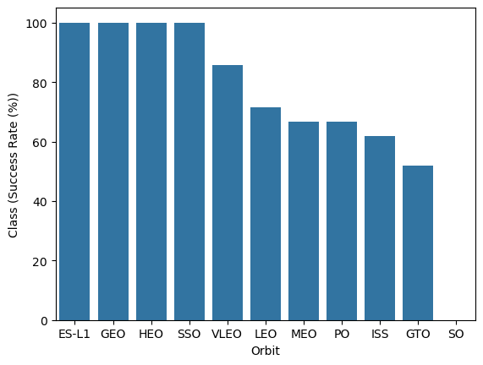
Success Rate vs. Orbit Type
We see that ES-L1, GEO, HEO and SSO have the best success rate (a 100%), while SO is the worst by a lot.

Slide 21
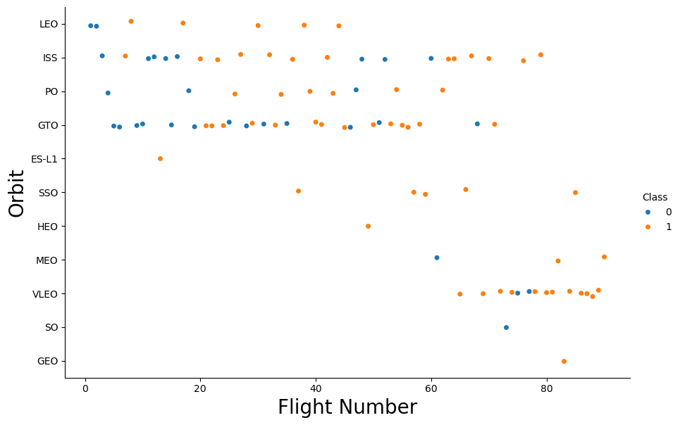
Flight Number vs. Orbit Type
The results may be biased because some orbits have very few launches compared to others.
Also, we notice that the greater the number of launches, the greater the probability of success.

Slide 22
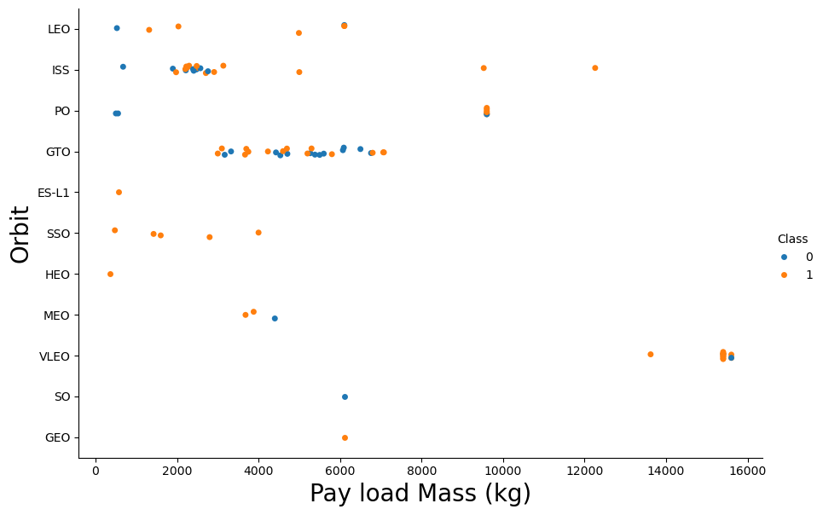
Payload vs. Orbit Type
It doesn’t seem to be a high relation, but, we can conclude that the amount of payload mass can be suitable for having a successful landing depending on the type of orbit, for example, for the ISS orbit the result is successful when it is between 5000 to 12000 kg.

Slide 23
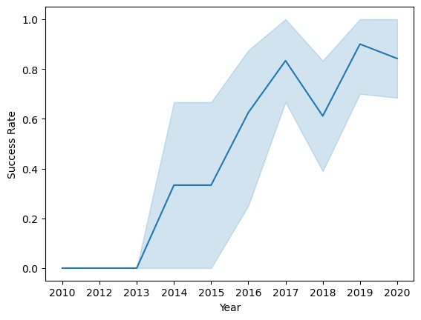
Launch Success Yearly Trend
The success rate started increasing in 2013 and keep increasing until 2020, having a marked growth, with 2019 being the year with the highest success rate.

Slide 24
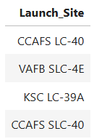
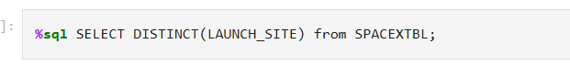
All Launch Site Names
There are four Launch Sites:
We use the query DISTINCT to show the data we want from the dataset SPACEXTBL:

Slide 25
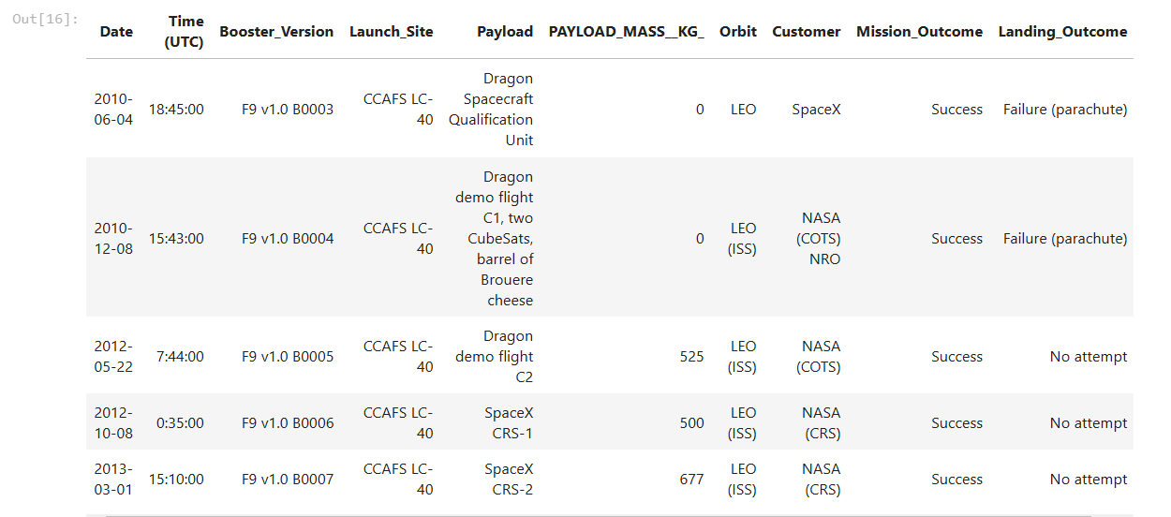
Launch Site Names Begin with 'CCA'
We used the operator “like” to search and show the launch sites that have the string CCA

Slide 26
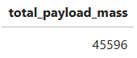
Total Payload Mass
The total payload carried by boosters from NASA was:
We used the followed query:

Slide 27
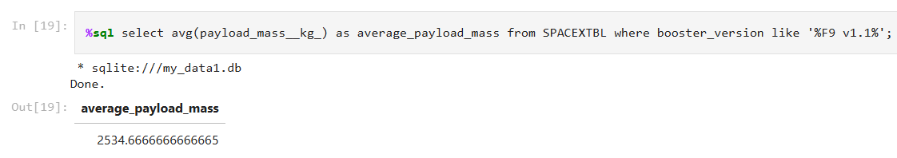
Average Payload Mass by F9 v1.1
We calculate the average payload mass carried by booster version F9 v1.1 with the query avg and it is 2,534.66

Slide 28
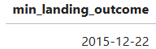
First Successful Ground Landing Date
We looked for a “Success (Ground pad)” from the column landing_outcome and use the query min for DATE to obtain the first successful ground landing date, the result is:

Slide 29
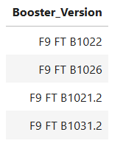
Successful Drone Ship Landing with Payload between 4000 and 6000
This are the boosters which have successfully landed on drone ship and had payload mass greater than 4000 but less than 6000
We used the followed query to show the result:

Slide 30
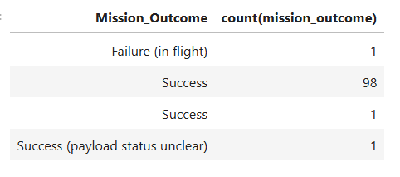
Total Number of Successful and Failure Mission Outcomes
We used count and GROUP BY to find the number of successful and failure missions

Slide 31
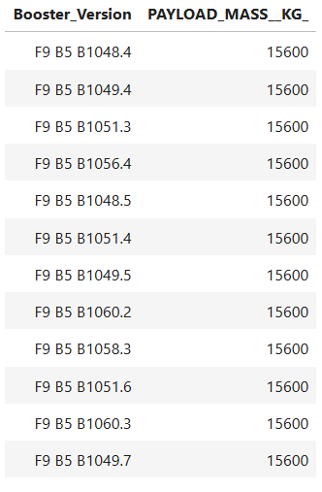
Boosters Carried Maximum Payload
These are the 10 boosters which carried the maximum payload with the followed code:

Slide 32
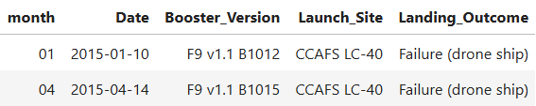
2015 Launch Records
There are only two failed landing_outcomes in drone ship in year 2015. We show their booster versions and launch site names.

Slide 33
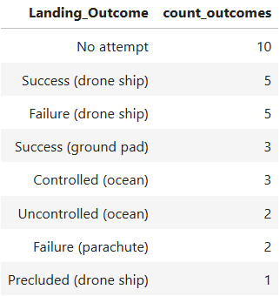
Rank Landing Outcomes Between 2010-06-04 and 2017-03-20
Here is the list of the landing outcomes (such as Failure (drone ship) or Success (ground pad)) between the date 2010-06-04 and 2017-03-20 in descending order.

Slide 34

Section 3

Slide 35
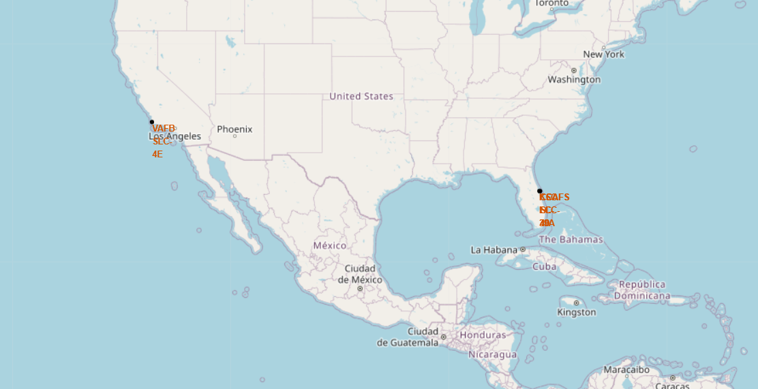
Launch Sites
We can see that the launch sites are in United States of America near by the ocean.

Slide 36
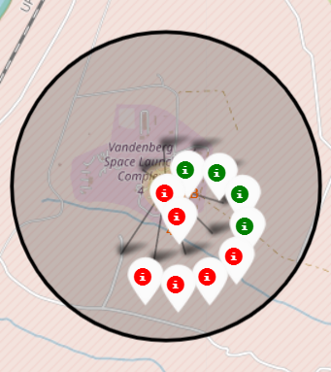
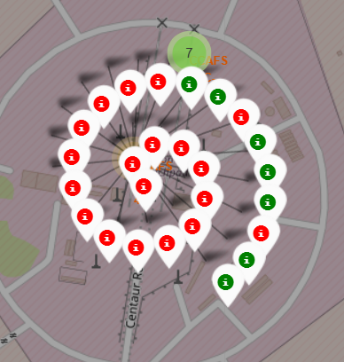
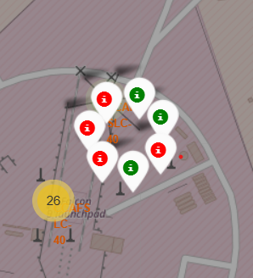
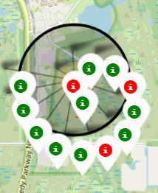
Successful and failed launches by sites
The green marks are for successful launches while the red ones are for the failed launches

Slide 37
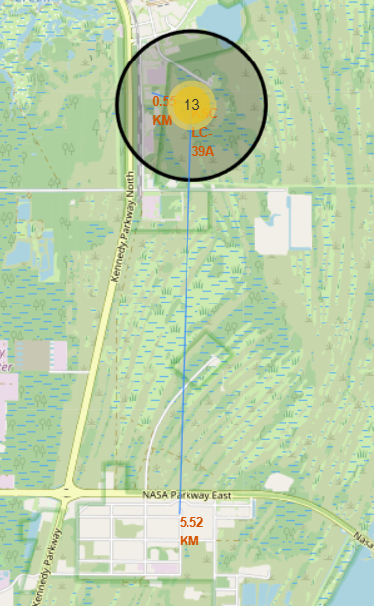
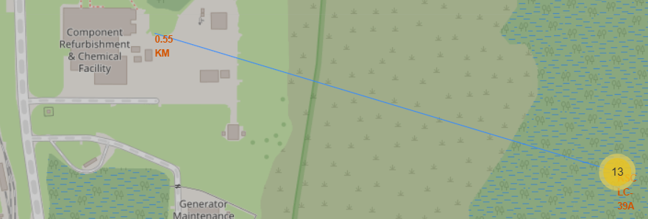
Launch sites distance
The launch sites are in close proximity to coastlines and keep a good distance far away from cities, making them safe for people.

Slide 38

Section 4

Slide 39
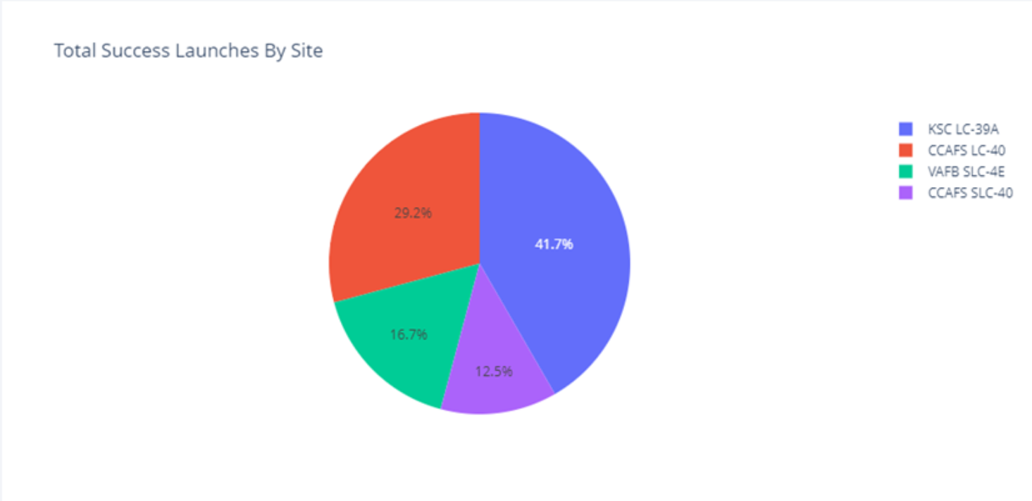
Success Launches by Site
As we can see, the KSC LC-39A has the most Success Launches, followed by CCAFS LC-40.

Slide 40
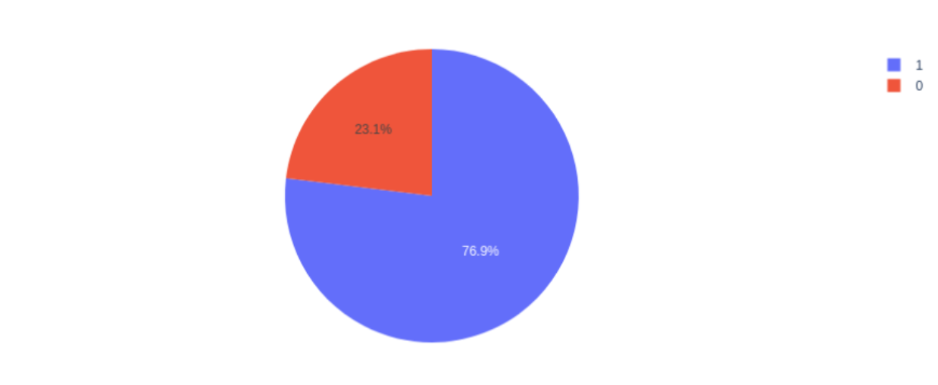
Successful launches for KSC LC-39A
We can see that there are mor successful launches (79.9%) than failed launches (23.1%).

Slide 41

Section 5

Slide 42
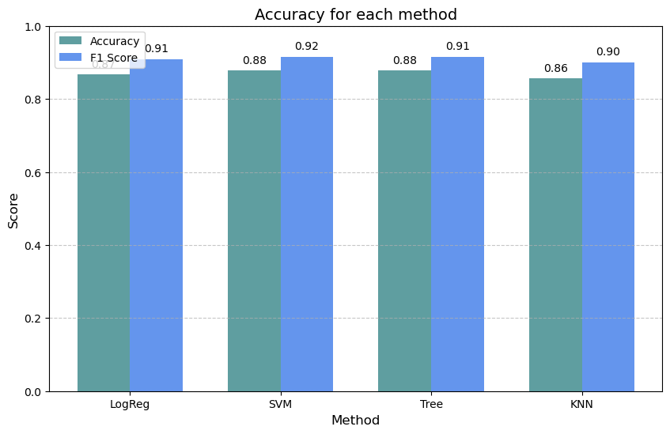
Classification Accuracy
We can see that the method SVM has the same accuracy as the Tree decision but it F1 Score it is better, so the Support Vector is the best method.

Slide 43
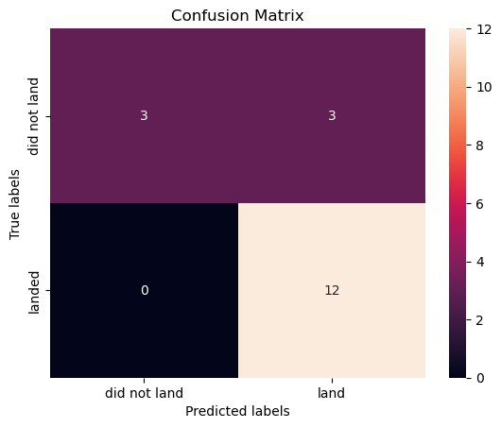
Confusion Matrix
We have mostly true positive predictions, however adjustments are needed to eliminate the 6 wrong predictions.

Slide 44
Conclusions
The analysis identified factors that influence launch success, such as number of flights, payload mass, and orbit type.
Machine learning methods (especially SVM and decision tree) proved effective in predicting successful launches, but may require adjustments to improve accuracy.
Launch sites are strategically located near the coast to minimize risk and maximize efficiency.
This project underscores the importance of data analysis and prediction in space operations. The combination of interactive visualizations, SQL queries, and classification models provides a solid foundation for improving SpaceX's success rates and optimizing future space missions.

Slide 45


